Slide 1
Icing
Factors affecting aeroplane performance

Slide 2
Types of icing, atmospheric conditions where it is encountered and engine induction icing
Applicable to Single and Multi Engine Piston aeroplanes.

Slide 3
Introduction
Ice will form on an airframe if there is:-
Water in a liquid state
Ambient air below 0°C
Airframe temperature below 0°C
Air frame icing can cause a serious loss of performance resulting in an increase in fuel consumption and difficulty with aircraft control.

Slide 4
Supercooled water
A supercooled water droplet is water still in the liquid state although it’s temperature is below 0°C
If the droplet contains a nucleus then it will start to freeze. Numbers of freezing nuclei exist in the atmosphere and supercooling is a frequent occurrence
Supercooled water droplets can exist in clouds at temperatures as low as –40°C

Slide 5
Types of Icing
Supercooled water droplets.
Clear or glazed ice.
Rime ice.
Rain ice.
Hoar frost.
Factors affecting severity of icing.
Freezing level.
Piston engine induction icing.

Slide 6
Effects.
AERODYNAMIC - Icing spoils the aerofoil resulting in reduced lift, increased drag, stalling speed and fuel consumption.
WEIGHT - Ice can form at a rate of one inch in two minutes affecting mass and balance.
Ice can break away from propellers causing engine vibration.

Slide 7
Effects.
INSTRUMENTS - Blocked pitot and static heads affect the ASI, VSI and Altimeter.
GENERAL - Windscreens can be obscured. A thin film of ice/frost increases skin friction. Ice on aerials causes static interference.
Notes:
Bow wave effect?

Slide 8
Clear (Glaze) ice.
Supercooled large droplets in contact with the airframe start to freeze releasing latent heat. This delays the process resulting in the flow back of clear ice. This ice can jam controls;
Clear ice forms in Ns, Cu and Cb at temperatures from 0 to -20°C.
Notes:
Large supercooled droplets.

Slide 9
Rime ice
Small supercooled droplets freeze on impact with the airframe sticking to form a white opaque deposit with a light texture;
Air intakes can be blocked;
Forms in parts of heaped clouds where temperatures are 0 to -40°C.
Notes:
Small supercooled water droplets.

Slide 10
Droplet sizes.
Notes:
Rime ice at front – glazed or clear ice at back.

Slide 11
Rain ice.
Rain ice occurs ahead of a warm or occluded front at low level during moderate to continuous rain at about 1 000 feet;
It is rare in the UK, but common in Central Europe and North America.
Notes:
Rare in UK.

Slide 12
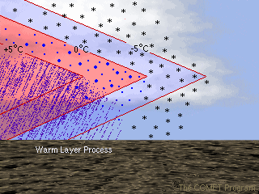
Supercooled small droplet
Notes:
Temperature inversion. Below 3000 feet. West or east coast?

Slide 13
Hoar frost.
Hoar frost is a white crystal deposit which appears similar to frost on the ground;
It forms when the airframe temperature is below 0°C and when clear ambient air temperatures drop to saturation level;
Water vapour in contact with the airframe is converted to ice crystals without becoming liquid i.e. sublimation;
It must be cleared before take-off.
Notes:
Airframe cools overnight.

Slide 14
Windscreen icing.
Notes:
How do you clear windscreen icing?

Slide 15
Supercooled water droplets.
Notes:
Twin Otter Supercooled Large Droplet Icing

Slide 16
Iced Wing.
Notes:
Rime ice on leading edge. If it flows back it is what type of icing?

Slide 17
Severity of icing.
The size of the supercooled water droplet is dependent on the cloud type and temperature;
There is always a greater concentration of droplets at the base of the cloud where it is warmest. Icing severity tends to be: Severe in Cu and Cb, moderate to severe in Ns and light to moderate in Sc;
The orographic effect of a range of hills increases uplift in cloud producing a greater concentration and size of supercooled water droplet.

Slide 18
Freezing Level.
The height where the ambient temperature is zero is called the freezing level;
Given in area forecasts as the Zero degree isotherm;
With an inversion two freezing levels are possible;
In the south of the UK the average freezing level in February is 3 000 feet.

Slide 19
Piston Engine Induction Icing.
Impact icing. Intake areas can be blocked by snow, pack snow or supercooled water droplets;
Fuel icing. Water in fuel freezing in the bends of induction piping;
Carburettor icing. This is caused by the sudden temperature drop as latent heat is absorbed when fuel evaporates and the temperature drop due to the adiabatic expansion of the air as it passes through the venturi.

Slide 20
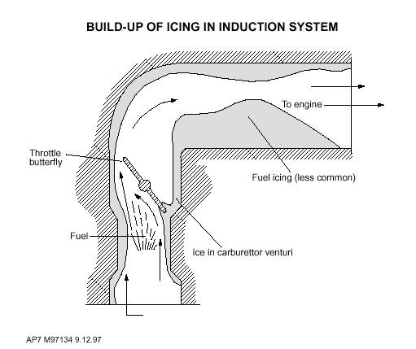
Piston Engine Induction Icing.

Slide 21
Carburettor Icing Notes:
More common with Mogas;
Greater problem with low power settings;
Occurs in clear air;
More of a hazard on warm, humid summer days;
High humidity indicators are: Wet ground, dew with light winds, poor visibility near water in mornings and evenings, flying below or between cloud layers, precipitation, fog, cloud and clear air just after fog has dispersed.

Slide 22
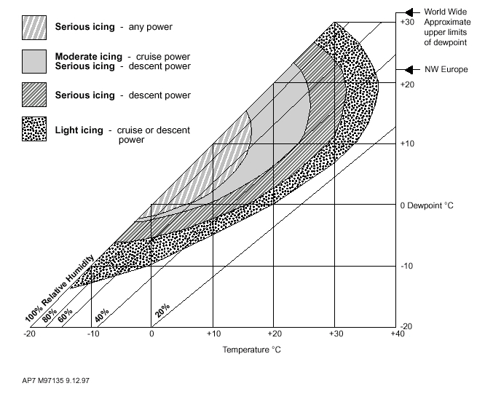
Carburettor Icing Conditions.

Slide 23
Summary.
Icing can be hazardous to aviation.
Clear ice is a major hazard to flight safety.
Rime ice is the most common form of icing.
Frost remaining on the wings is dangerous, especially during take-off.
When the air is moist carburettor icing can form in temperatures as high as 25°C
An ice laden aeroplane may be completely incapable of flight.

Slide 24
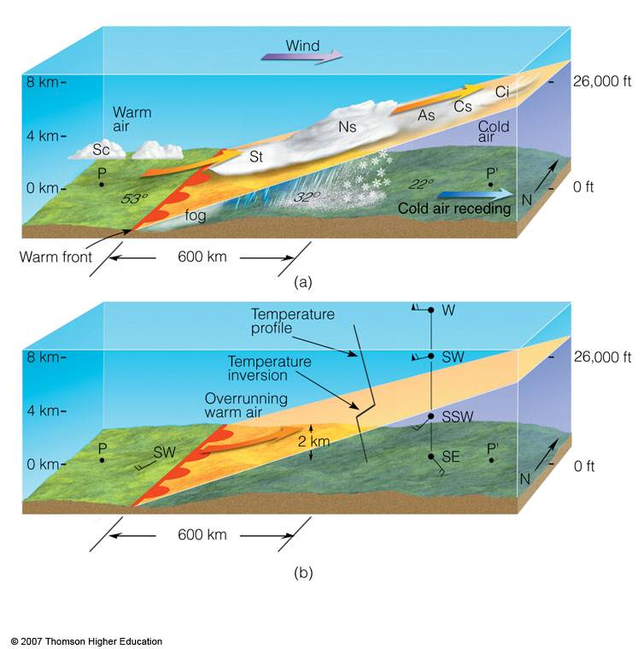
Warm front profile

Slide 25
Where to Get More Information.
Trevor Thom Air Pilot’s Manual 2-Air Law and Meteorology;
AIC 106/2004 Frost Ice and Snow on aircraft
General aviation safety sense leaflets 3 Winter flying and 14 Piston Engine Icing;
www.ais.org.uk

